Slide 1
기본 프로그래밍 04
데이터융합SW과
김규석 교수
JAVA

Slide 2
P1
Program to Calculate the Probabilities
User inputs the numbers N and M
Print all the cases when the sum is M when throwing N of dice
2
6
(1, 5)
(2, 4)
(3, 3)
(4, 2)
(5, 1)
Notes:
N번을 던져서 m의 합이 되게

Slide 4
P2
Banking System
This program runs indefinitely until the user tries terminating it
#Menu
Deposit
Withdrawal
Balance : 0
-> 1
10000
#Menu
Deposit
Withdrawal
Balance : 10000
-> 2
2000
#Menu
Deposit
Withdrawal
Balance : 8000

Slide 5
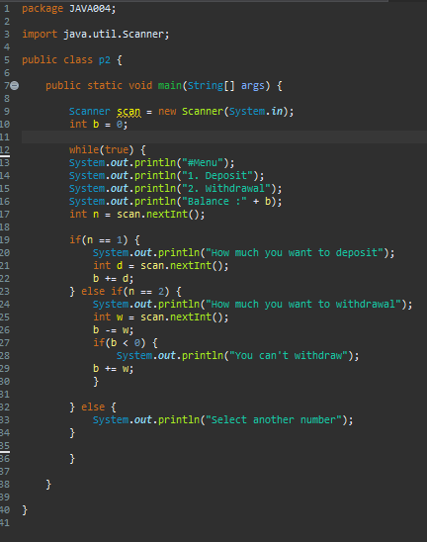
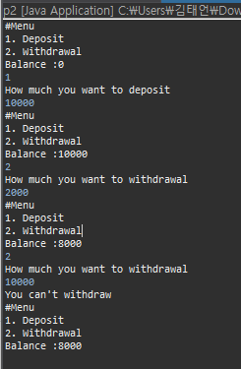
P2

Slide 6
P3
Program to Calculate the Sum of Multiples of N
User inputs the two numbers for the M and N respectively
Calculate the sum of multiples of N from 1 to M
20
5
SUM : 50(5, 10, 15, 20)

Slide 7
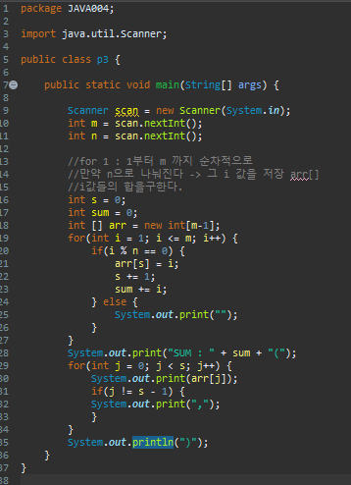

P3

Slide 8
P4
Encryption and Decryption
Create your own encryption algorithm
e.g., a->b, b->c, c->d, d->e
#Menu
Encryption
Decryption
-> school
Result : tdippm
2. Encryption
3. Decryption
-> tdippm
Result : school
Notes:
암호화 로직을 짜라
복호화 부호화

Slide 9
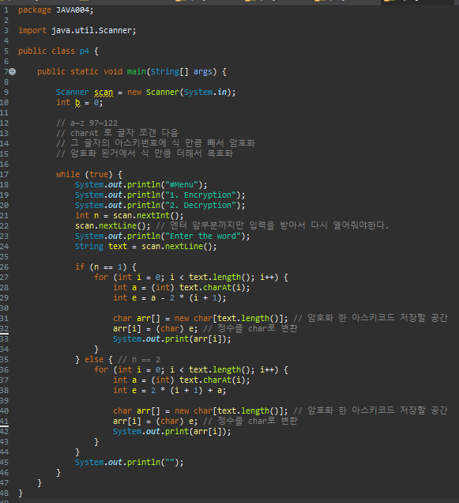
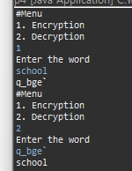

Slide 10
P5
Data Confirmation
Set up your conditions
The number of conditions should be at least 5
e.g.,
#1 : The string length should be over 10
#2 : The string should contains the character ‘k’
….
-> abdefewqqwer
FAIL
-> kdefkdie123
PASS
Notes:
암호 만들때 규정
몇글자 이상
특수문자 포함 이런것들

Slide 11
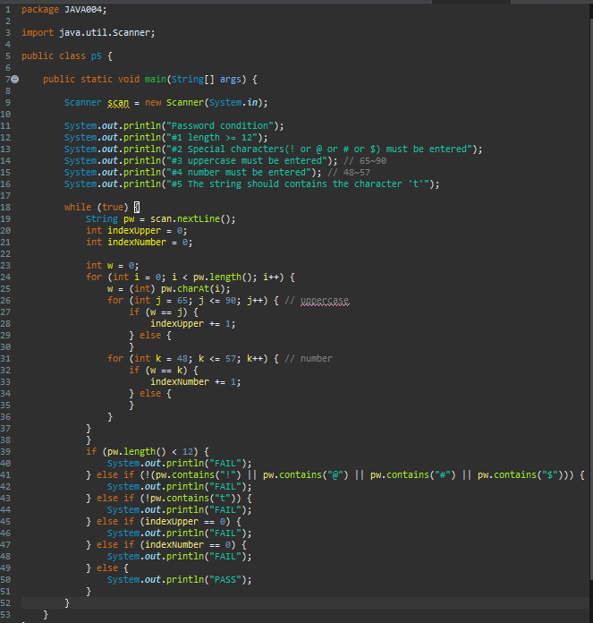
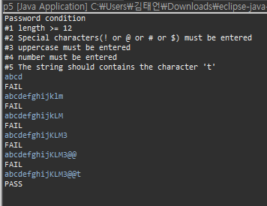
P5

